Slide 1




Fundamentals of Database Management System
~Md. Sabbir Hossain Bhuiyea (Rossi)
Four Types of Sentences

Slide 2
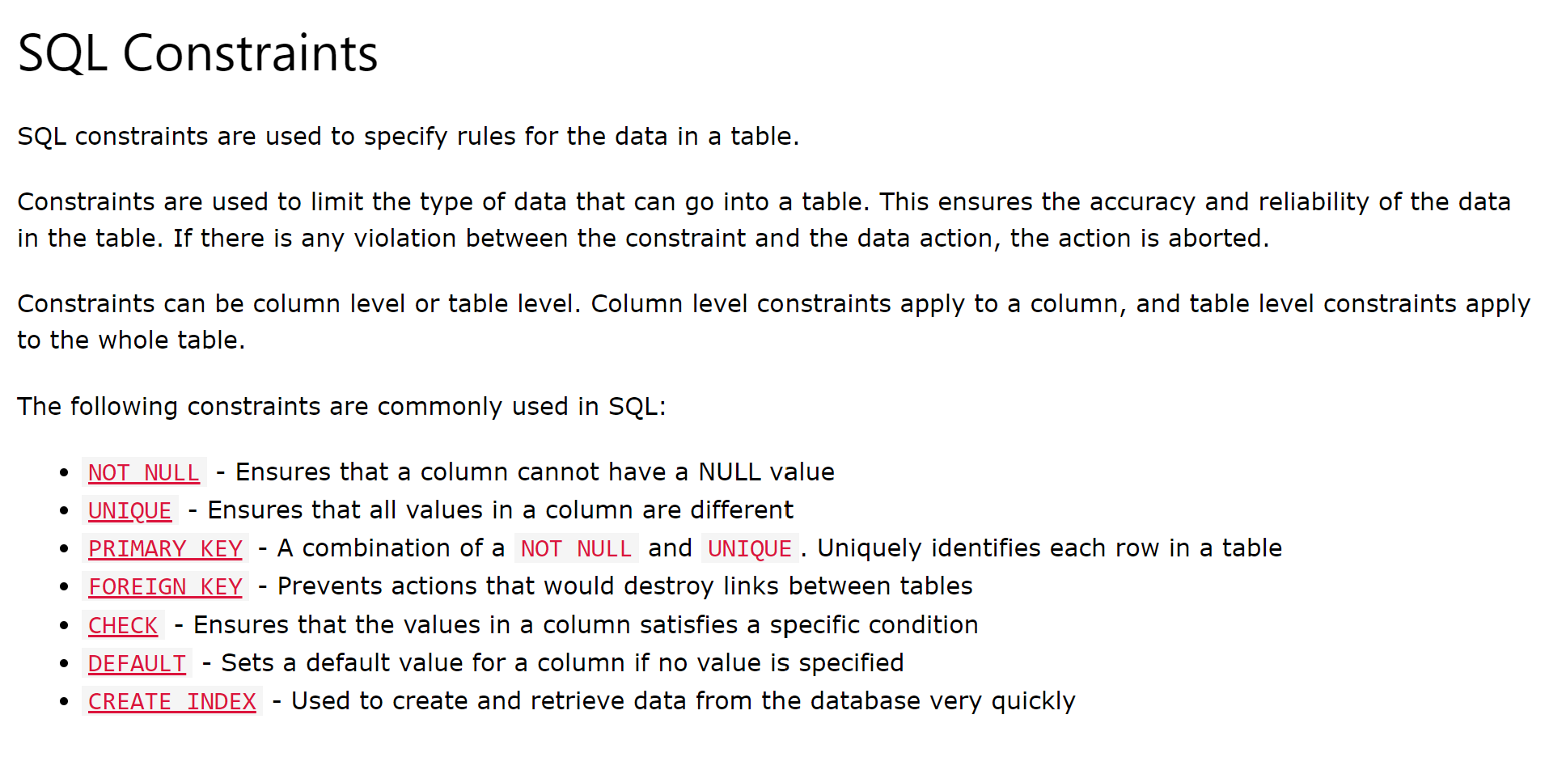

Slide 3
What Is Normalization?
Normalization is a database design technique that reduces data redundancy and eliminates undesirable characteristics like Insertion, Update and Deletion Anomalies. Normalization rules divides larger tables into smaller tables and links them using relationships.
The inventor of the relational model Edgar Codd proposed the theory of normalization of data with the introduction of the First Normal Form, and he continued to extend theory with Second and Third Normal Form. Later he joined Raymond F. Boyce to develop the theory of Boyce-Codd Normal Form.
Details: https://www.guru99.com/database-normalization.html

Slide 4
What Is Denormalization?
Denormalization is a strategy used on a previously-normalized database to increase performance. In computing, denormalization is the process of trying to improve the read performance of a database, at the expense of losing some write performance, by adding redundant copies of data or by grouping data.

Slide 5
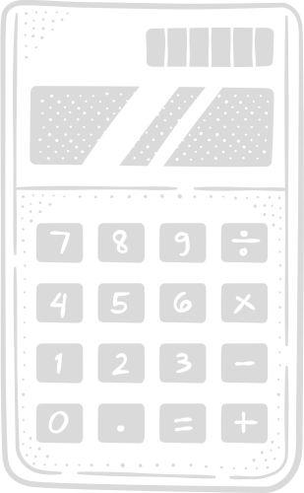
Types of databases
There are many different types of databases. The best database for a specific organization depends on how the organization intends to use the data.
Relational databases
Object-
oriented databases
Distributed databases
NoSQL databases
Cloud databases
JSON database

Slide 6
What Is a NoSQL Database?
A NoSQL database provides a mechanism for storage and retrieval of data that is modeled in means other than the tabular relations used in relational databases.
NoSQL systems are also sometimes called Not only SQL to emphasize that they may support SQL-like query languages or sit alongside SQL databases in polyglot-persistent architectures.
The data structures used by NoSQL databases (e.g. key–value pair, wide column, graph, or document) are different from those used by default in relational databases, making some operations faster in NoSQL.

Slide 7
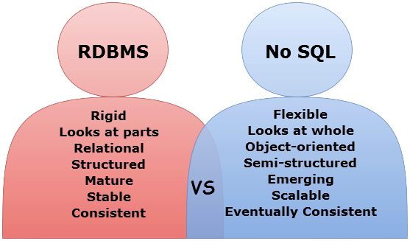
Key differences between SQL and NoSQL databases

Slide 8
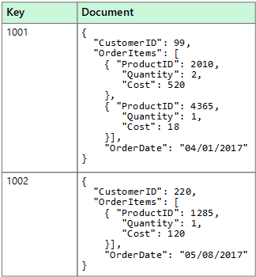
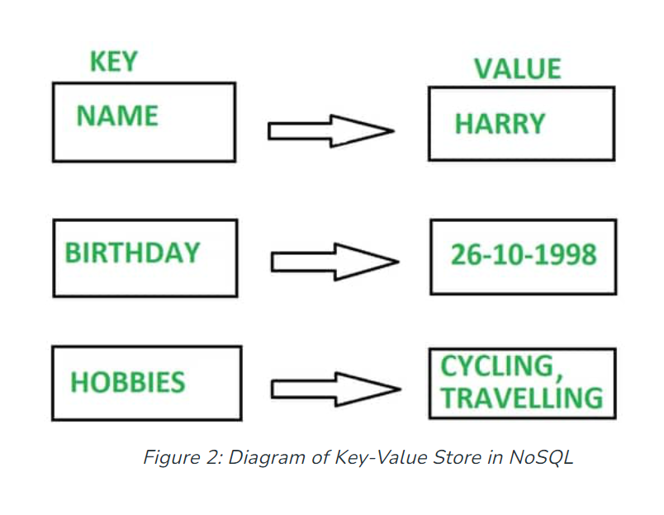

Slide 9
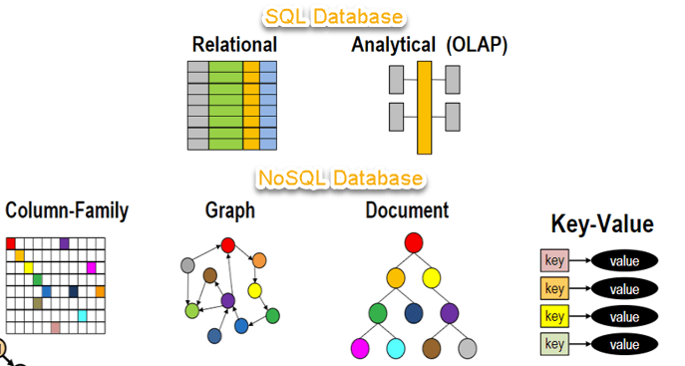
SQL vs. NoSQL Database Type?

Slide 10

Different Database
●Relational (SQL Server, Oracle, MySQL, PostgreSQL, SQLite)
●NoSQL ( MongoDB, Apache Cassandra, CouchBase)
●Cloud (Azure, AWS RDS, Oracle Autonomous)
●Columnar (Bigquery, Mariadb)
●Wide Column (Bigtable)
●Object Oriented(ObjectStore)
●Key-value (Redis, Dynamodb)
●Hierarchical (Win Registry)
●Document (Documentdb, Mongo)
●Graph (Neo4j)
●Time series (Influx, Druid)

Slide 11

ACID
BASE
Basically Available
Atomicity
Consistency
Soft State
Isolation
Eventually Consistent
Durability

Slide 12
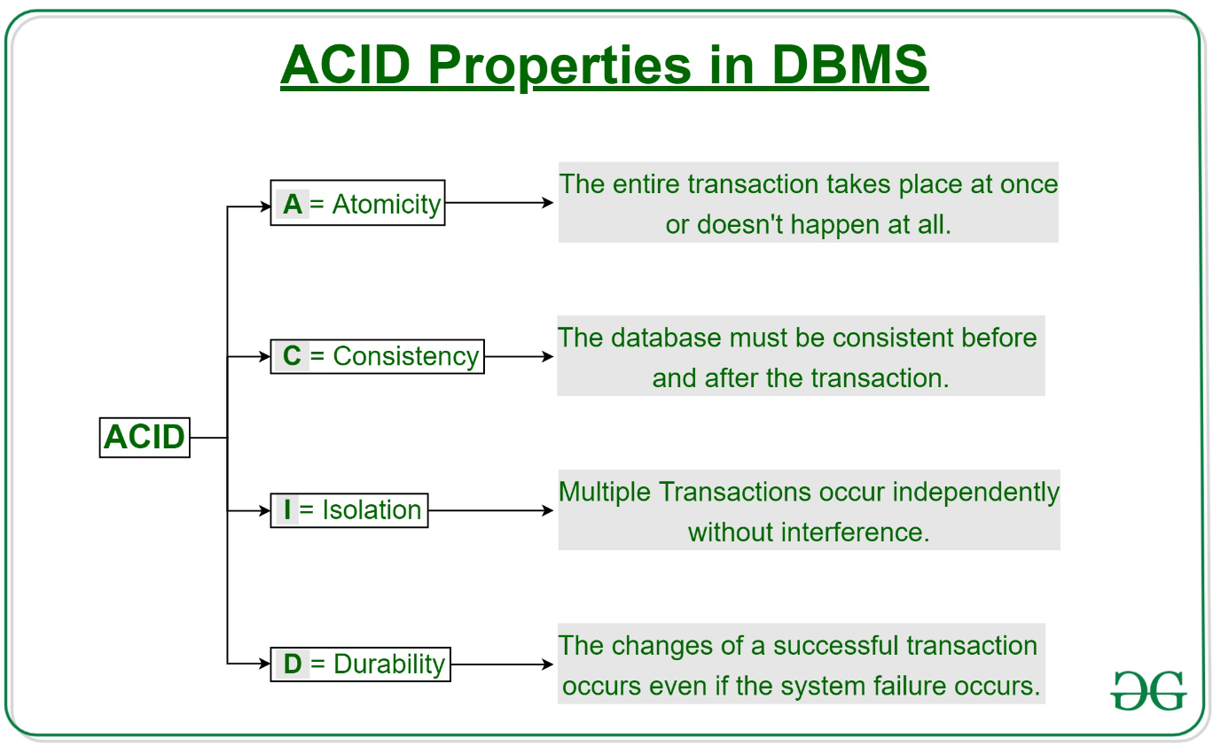

Slide 13
